Slide 1


Getting started with Polars (when DataFrame gets little too )
Suman Debnath
Developer Advocate, Data Engineering
Amazon Web Services

Slide 2

Its really fast …

Slide 3
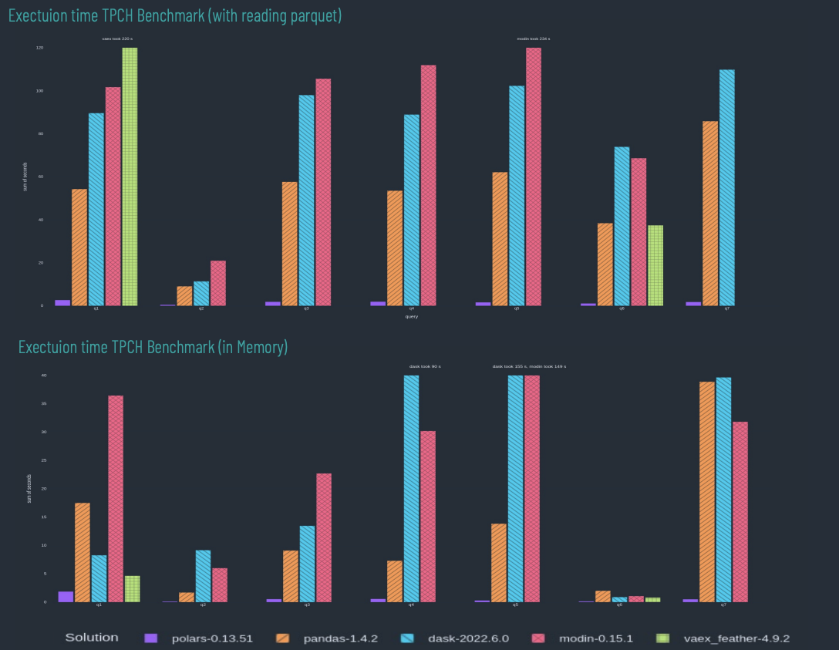
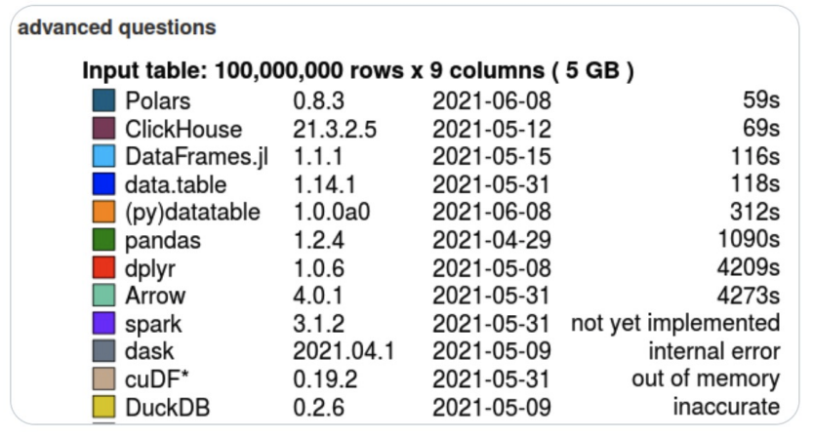
Its really fast …

Slide 4





world of df

Slide 5

polars
powerful data manipulation and analysis library
written in Rust (created by Ritchie Vink)
uses Apache Arrow
native arrow2 Rust implementation
available with multiple languages
python, rust and NodeJS
memory efficiency
similar to Arrow, which reduces memory overhead and improves memory utilization
expressive API
Chains of expressions build an optimized query plan
Interoperability
integrates seamlessly with other data processing frameworks, such as Apache Arrow, enabling efficient data interchange between different systems

Slide 6
key features
fast flexible analysis with the Expression API
easy parallel computations
automatic query optimization in lazy mode
streaming to work with larger-than-memory datasets

Slide 7
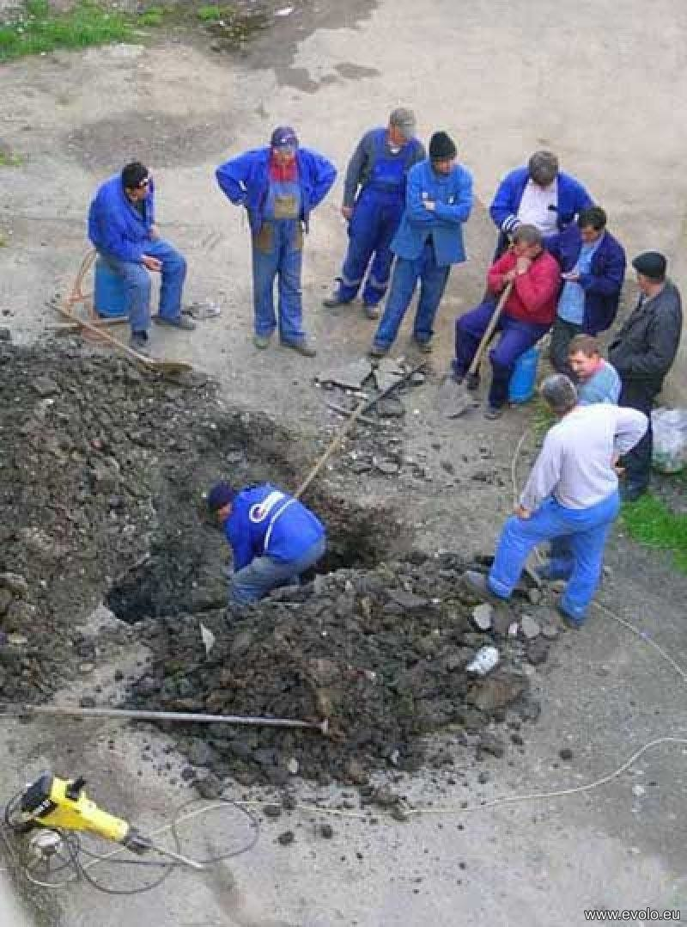
embarrassingly parallel
without parallelization
CORE2
CORE1
CORE3
GPU
CORE5
CORE7
CORE4
CORE6

Slide 8

embarrassingly parallel
without parallelization
multi-core parallelization done wrong
CORE2
CORE1
CORE3
GPU
CORE5
CORE7
CORE4
CORE6

Slide 9
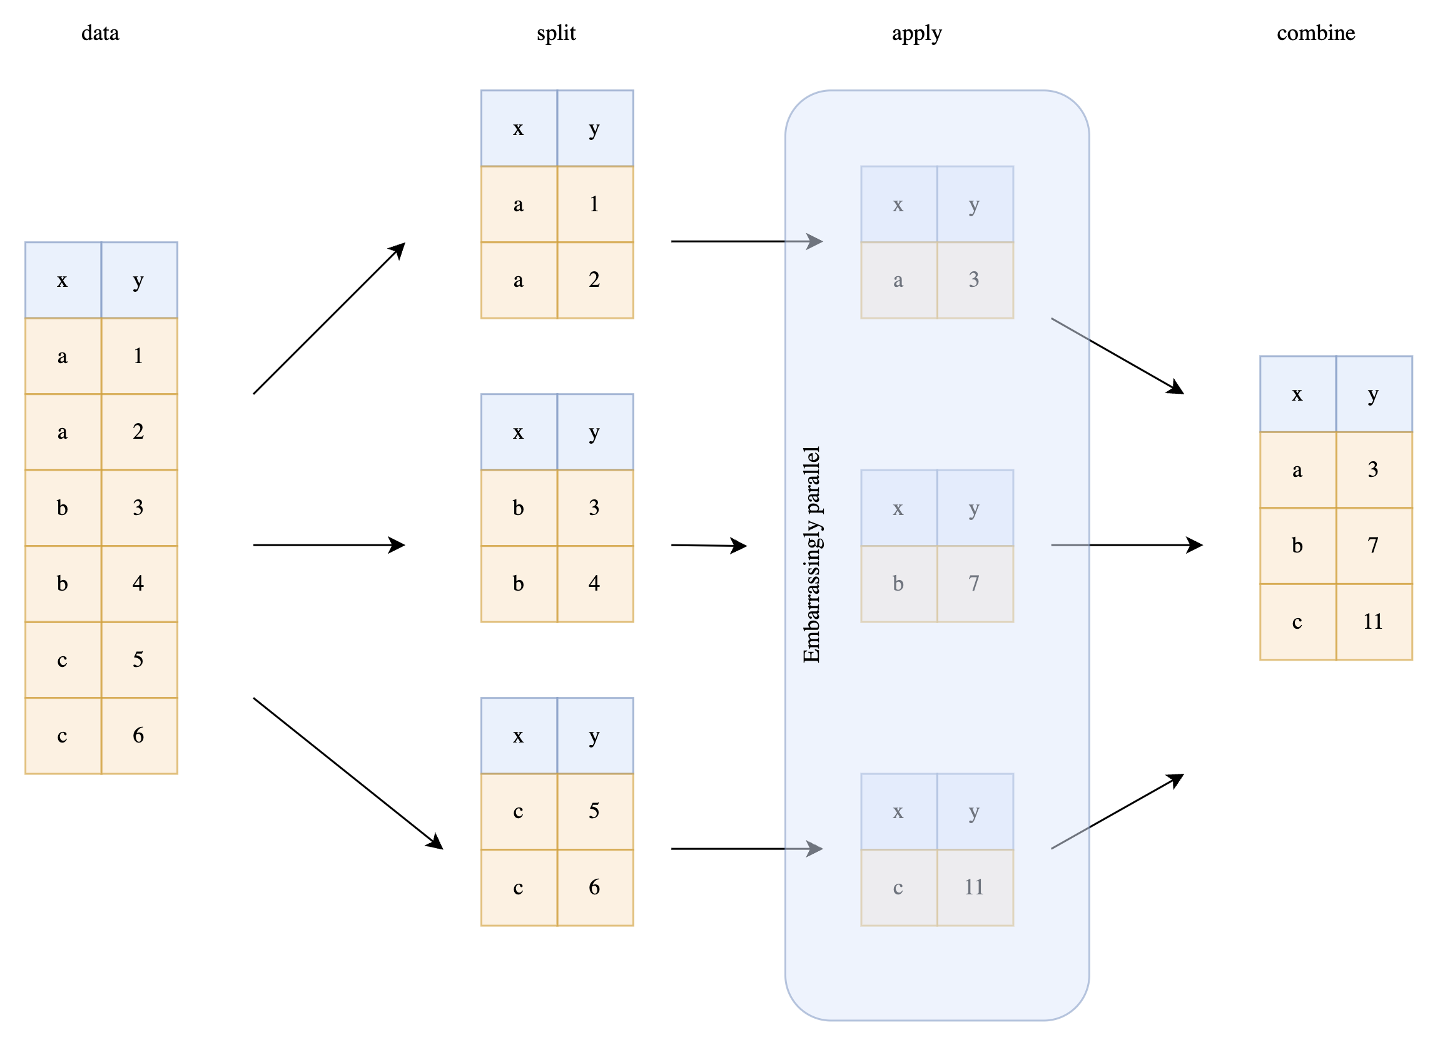
parallelization
embarrassingly parallel
aggregations across different cols
groupby operations can be parallelized
https://www.ritchievink.com/blog/2021/02/28/i-wrote-one-of-the-fastest-dataframe-libraries/

Slide 10
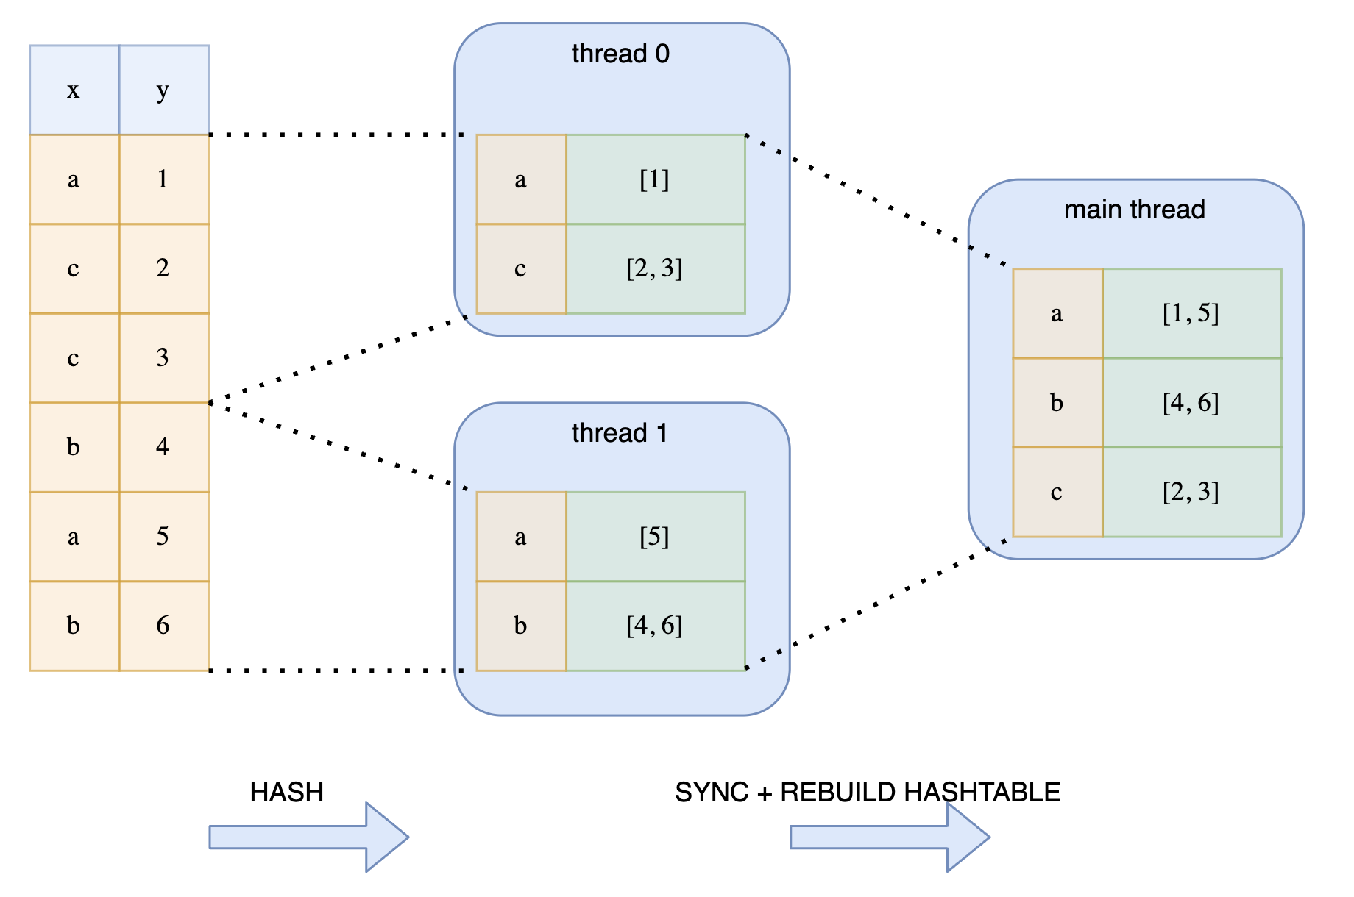
parallel hashing
Expensive synchronization
data split into threads
each thread applies operations independently
there is no guarantee, that a key doesn’t fall into multiple threads
extra synchronization step necessary
https://www.ritchievink.com/blog/2021/02/28/i-wrote-one-of-the-fastest-dataframe-libraries/

Slide 11
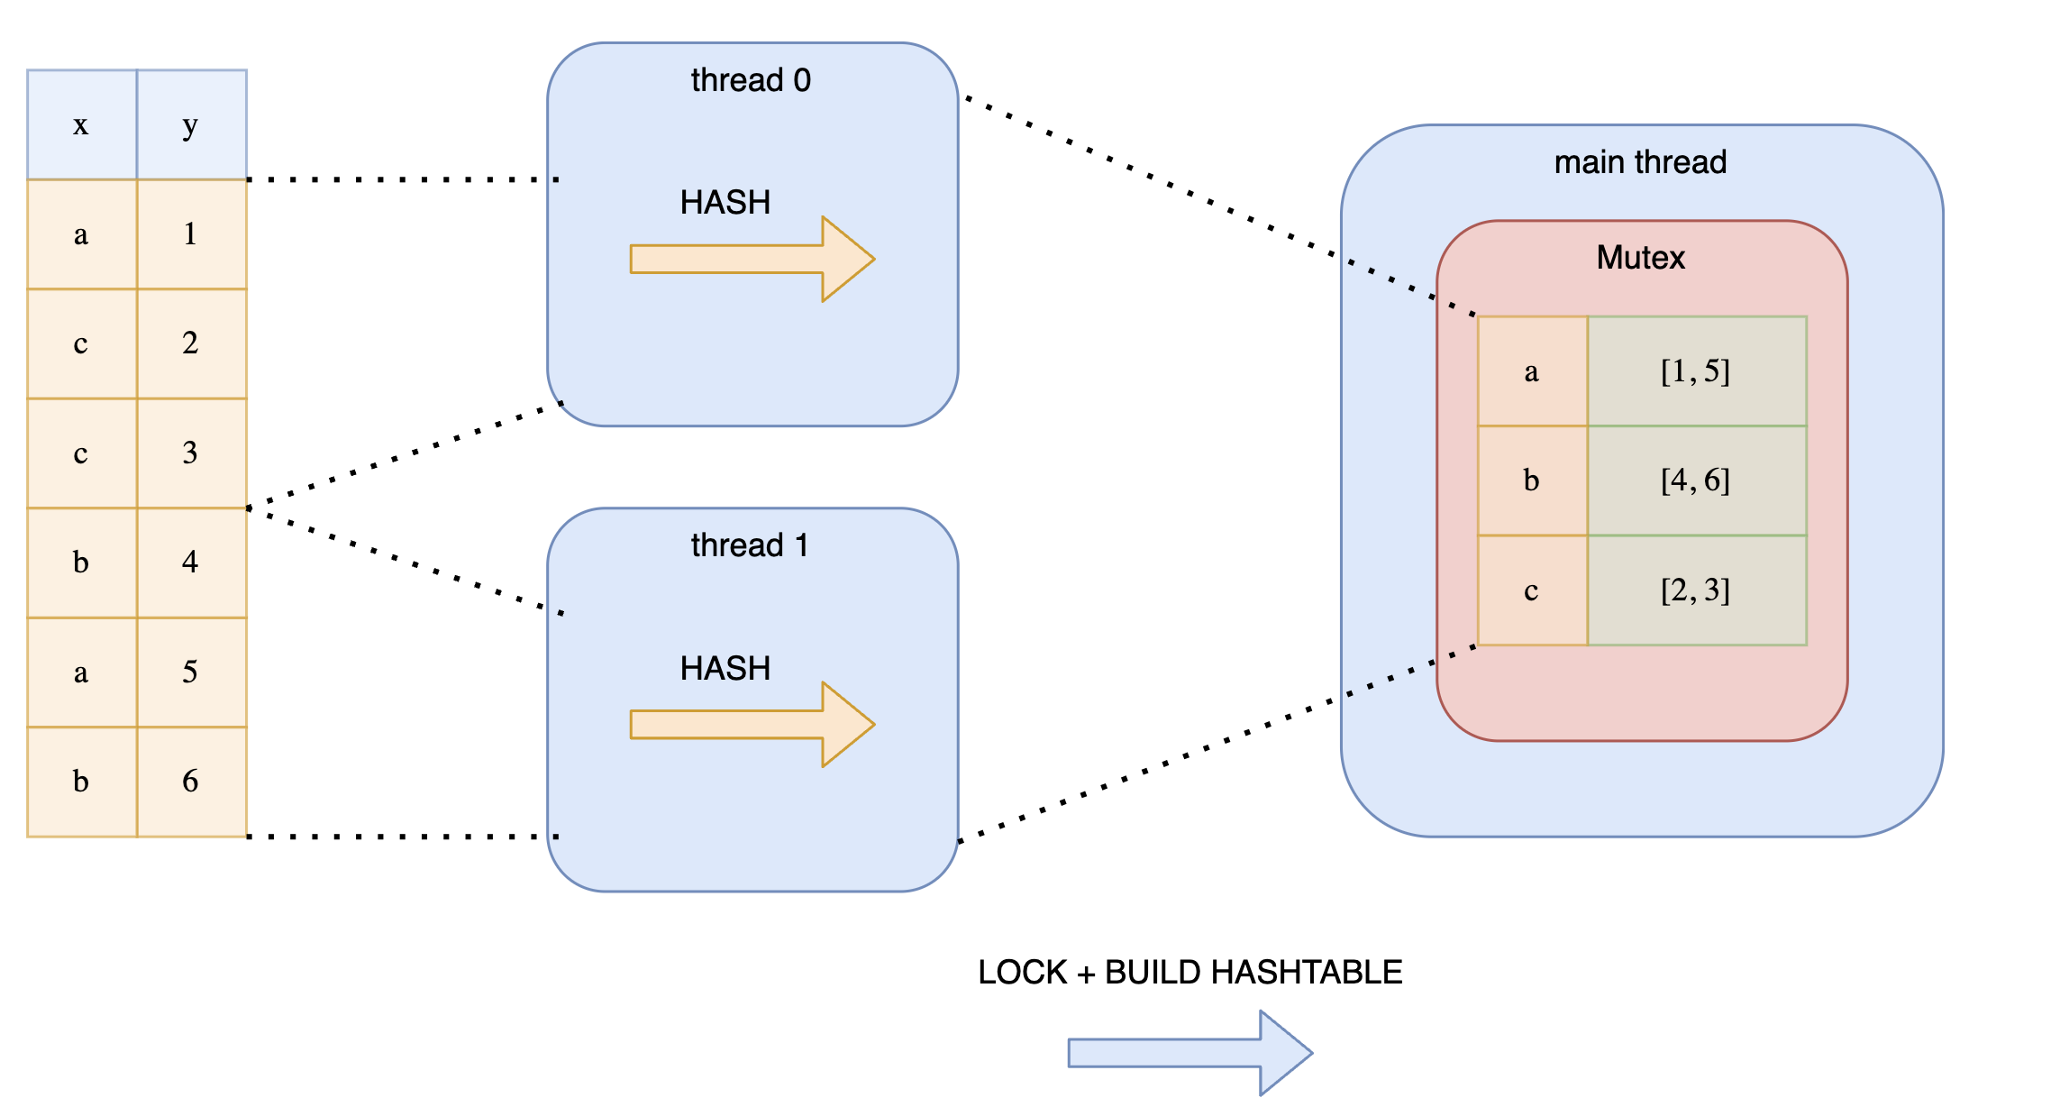
parallel hashing
Expensive locking
data split into threads
threads have shared storage (mutex) to prevent duplicates
but different threads blocks each other
https://www.ritchievink.com/blog/2021/02/28/i-wrote-one-of-the-fastest-dataframe-libraries/

Slide 12
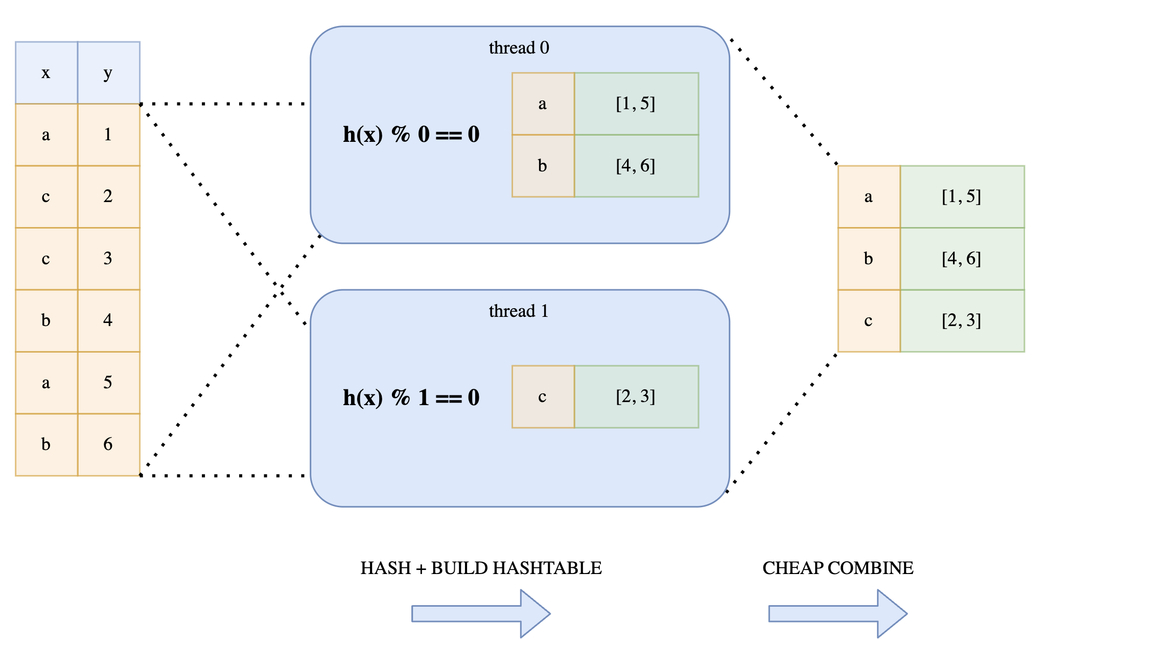
parallel hashing
Lock-free hashing
all threads reads the full data
threads independently decides which value to operate on by a modulo function
results can be cheaply combined by trivial concatenation
https://www.ritchievink.com/blog/2021/02/28/i-wrote-one-of-the-fastest-dataframe-libraries/

Slide 13
a Data Engineer – that’s all I want!
# select/slice columns
select
# create/transform/assign columns
with_columns
# filter/slice/query rows
filter
# grouping dataframe rows
groupby
# aggregation
agg
# sort the dataframe
sort

Slide 14
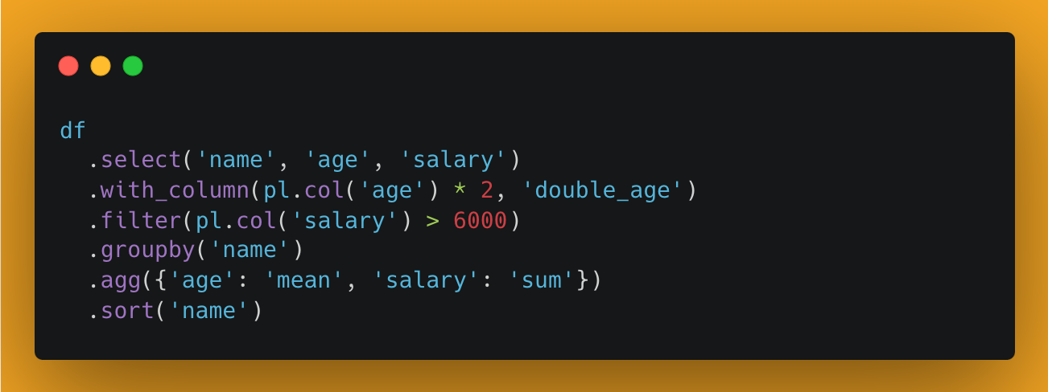
a Data Engineer – that’s all I want!
# select/slice columns
select
# create/transform/assign columns
with_columns
# filter/slice/query rows
filter
# grouping dataframe rows
groupby
# aggregation
agg
# sort the dataframe
sort

Slide 15

I'm still growing ☺

Slide 16

lets get started
debnsuma/pycon_polars101

